Slide 1
Understanding Online News Popularity

Slide 2
Our Questions and Their Importance
Business Goal: Increasing popularity of news by customizing it in popular format.
What is the best day to release a new article? Does the ideal day vary with the type of news?
How does the number of images and the number of words in an article affect the number of shares?
Does the rate of sharing of positive and negative news vary with the time of the year?
Notes:
1.How to add Importance and the questions in 1 slide without making it verbose? May be write one line for importance and talk about it more?
2. Talk about how each research question can help digital media companies

Slide 3
Target Audience

Slide 4

Digital Media Firms
The aim of our analysis is to identify characteristics of an article that significantly affect the number of times it is shared. By identifying these factors, digital media publishing firms will be able to maximize the number of shares on any given article, thereby maximizing popularity of articles.

Slide 5
THE DATA SET
Contains details about articles published on Mashable from 2013 - 2015

Slide 6
39,644 Rows
61 Columns
1 Dependent Variable
Number of Articles
Number of Attributes
Number of Shares
Notes:
1. Talk about data set, articles from 2013 to 2015, give examples of attributes #images, #words in title etc. etc.
2. #shares is our DV, “With our analysis, we tried to study the effect of independent variables on this”

Slide 7
Research Questions
In depth review of the three aspects of research conducted

Slide 8
Best Day of Release
1
What is the best day to release an article? Does the day vary with the type of news?
Notes:
We have a total of 8 minutes. I’m thinking, 2 mins for intro (our data set, target audience etc.) and then 2 mins. Per research question. Add slides for each of your research questions accordingly!

Slide 9
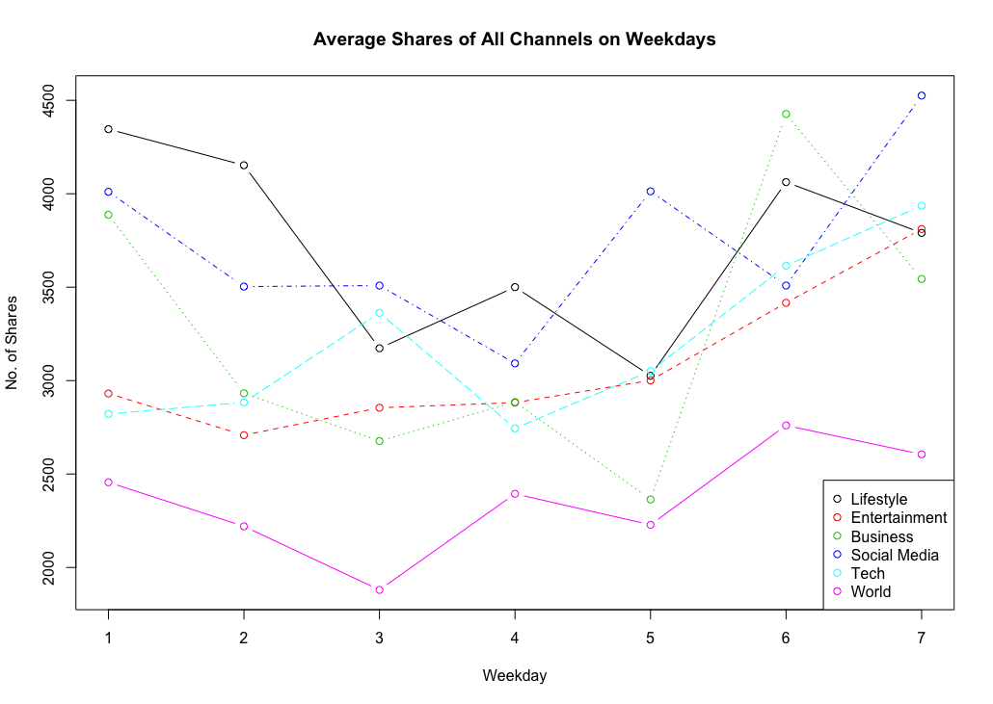
Lifestyle
Entertainment
Business
Social Media
Tech
World
Mon
Sun
Sat
Sun
Sun
Sat
Shares of different kind of articles vary, but in general, people read and share more articles on weekends.

Slide 10
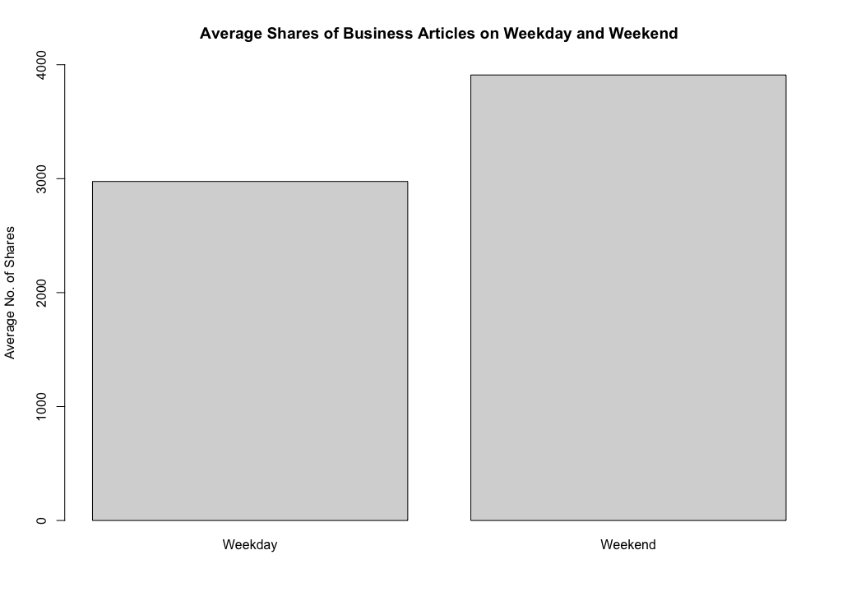
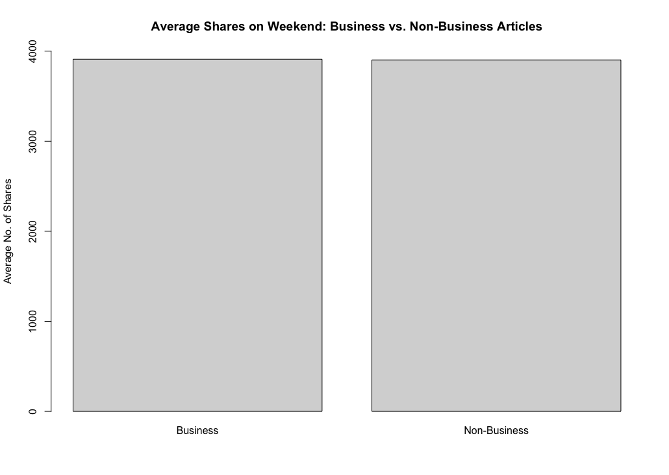
On weekends, business articles are shared more than weekdays.
However, the number is almost the same compared to other kind of articles.
Notes:
One example, business news, which was a part of our first question, represents weekday vs. weekend.

Slide 11
Optimal Number of Images/Words
2
How does the number of images and the number of words in an article affect the number of shares?

Slide 12
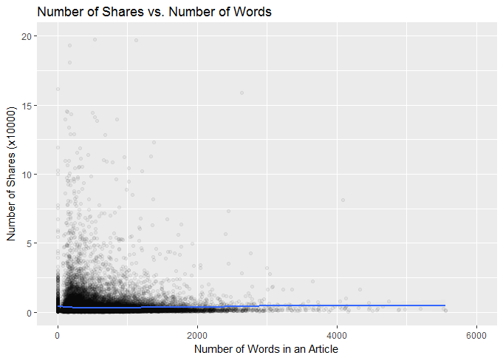
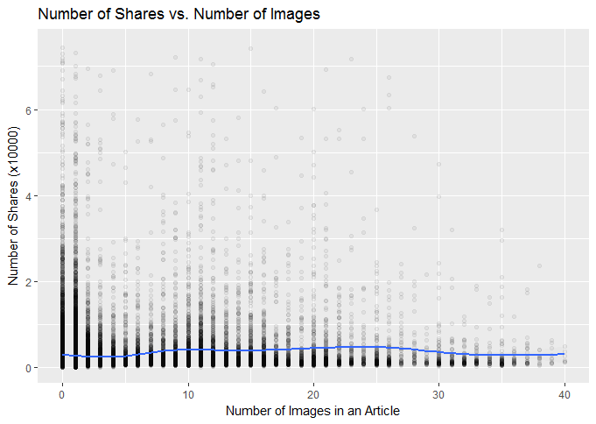
Number of Shares with respect to the number of Words in an article
Number of Shares with respect to the number of Images in an article

Slide 13
Analysis: Linear Regression
Number of Words
F(1,39642)=0.239, p=0.62
The number of words does not have a significant relationship with the shares of an article.
Number of Images
F(1,39642)=61.6, p=4.3x10⁻¹⁵
The number of images in an article is positively related to how much it is shared and can be represented in a linear regression model.

Slide 14
Regression Model
The linear regression model can be expressed as:
Shares = 3144.9 + 55.113 (No. of Images)
This can be interpreted as follows:
With every 1 count increase in the image in an article the shares increase by 55.113.

Slide 15
Polarity of News
3
Does the rate of sharing positive and negative news vary with the time of the year?
Notes:
Read the question. First, we wanted to check that does the number of shares even depend on the type of articles? Or is it purely a function of the number of articles published?

Slide 16
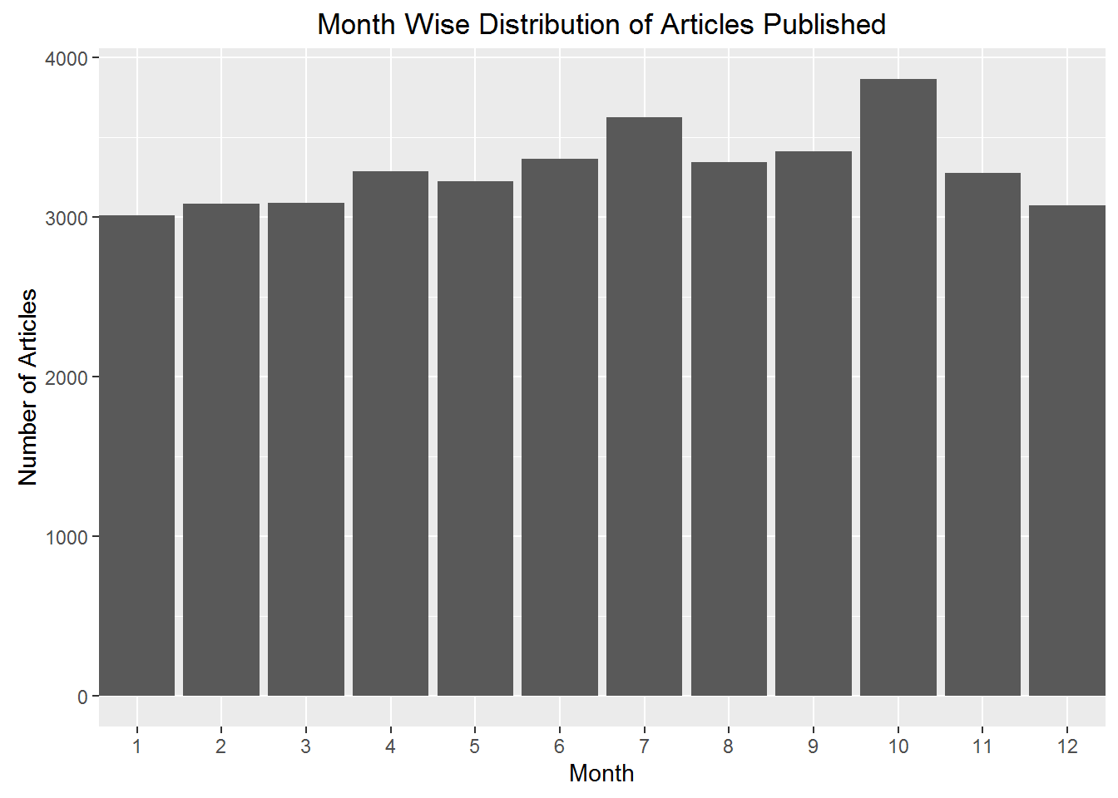
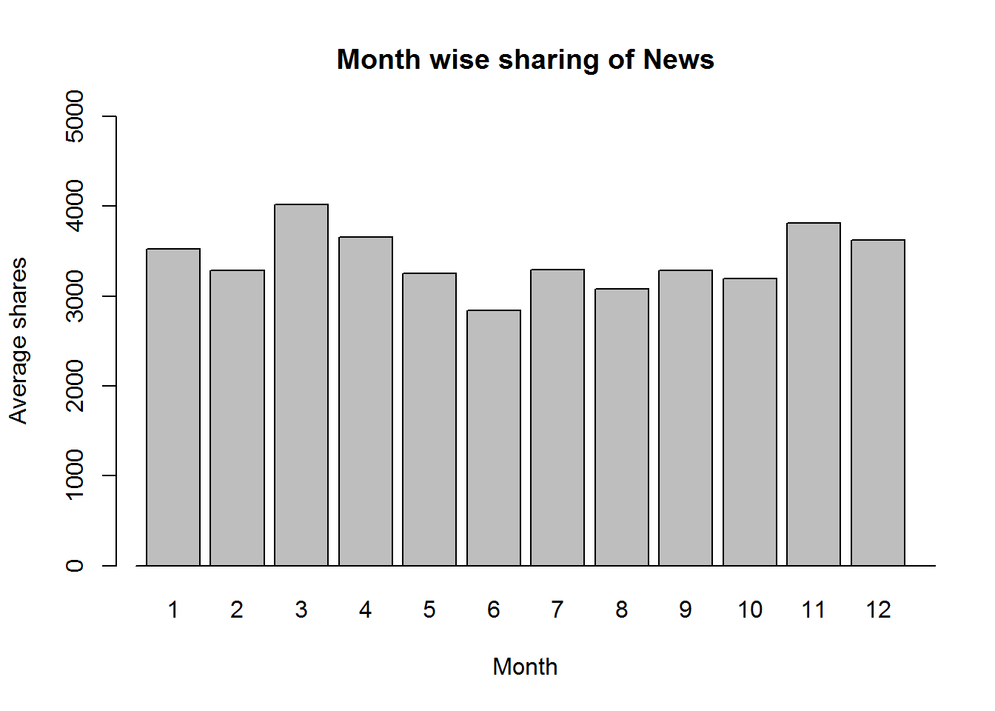
Maximum articles are published in the month of October
Average number of shares are maximum for the month of March
Notes:
These 2 graphs make it clear that higher number of articles published doesn’t mean more shares. Content of the articles matters.

Slide 17
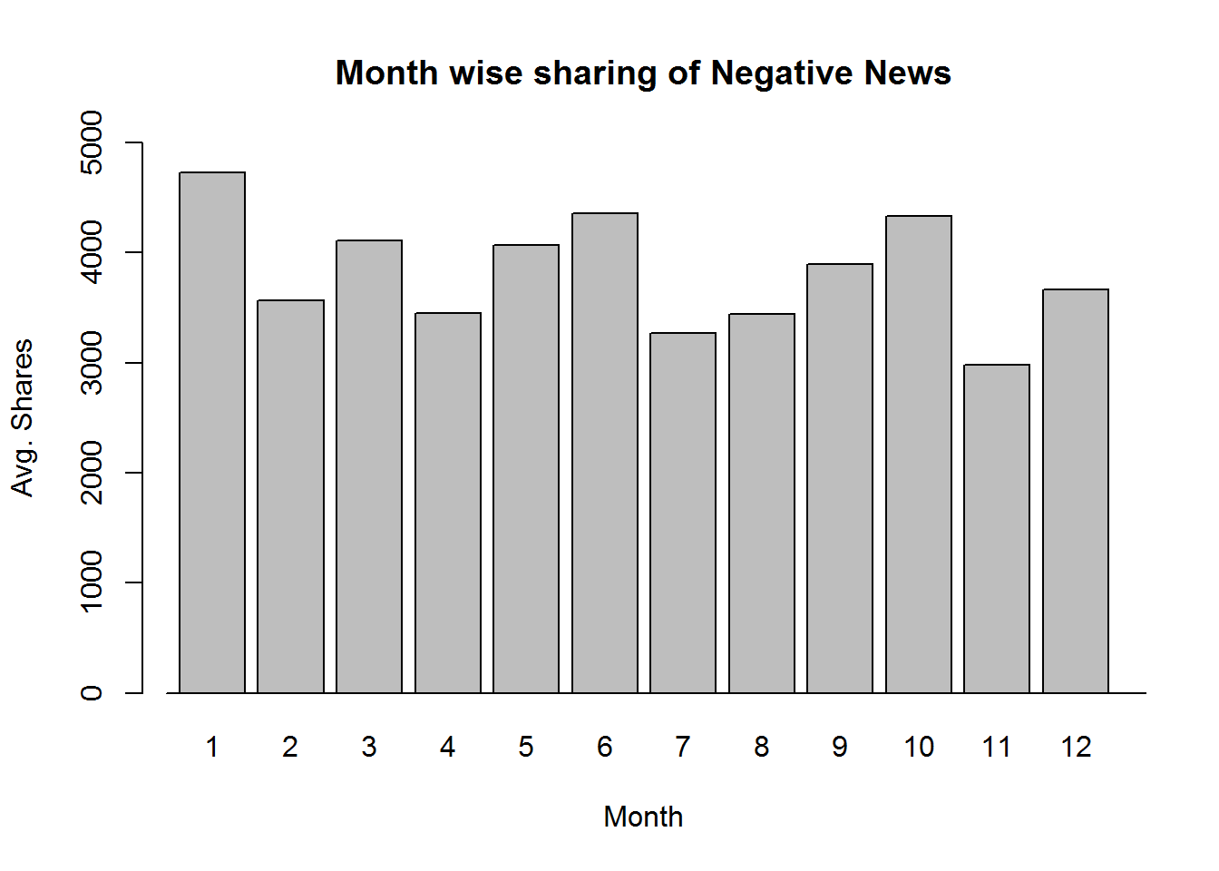
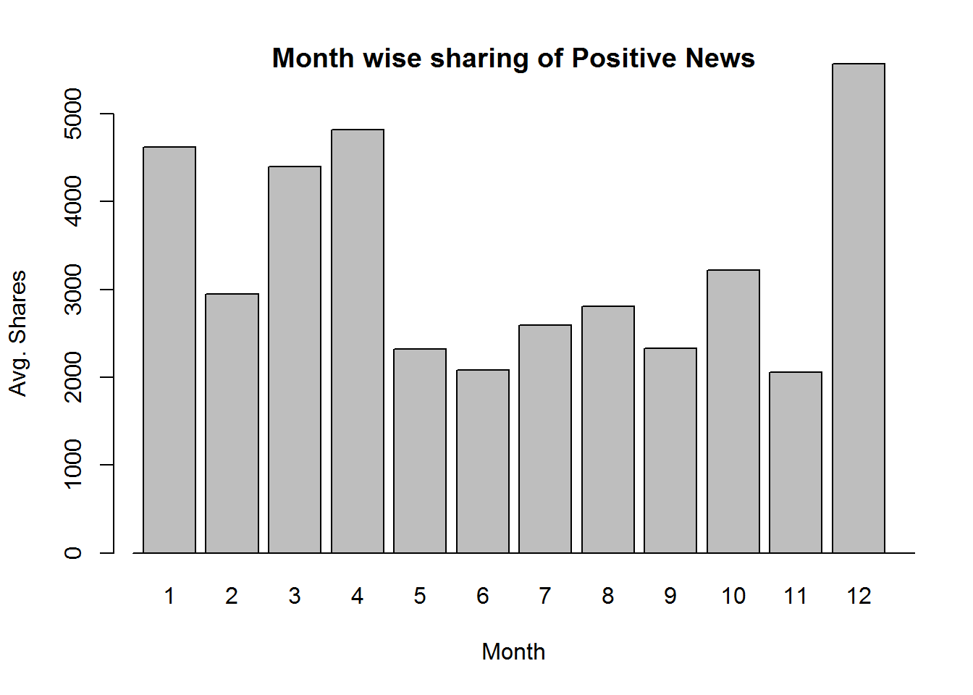
Maximum negative news shared in the month of January
Maximum positive news shared in the month of December
Notes:
What is positive and negative news? - we had the total number of negative and positive words in an article. We calculated the average number of positive/negative words in an article. Articles with at least twice the average were considered as positive/negative news. Other methods could also be used.

Slide 18
Analysis of Variants (ANOVA)
Negative News
F(1,653)=1.53, p=0.21
Even though some months have higher average than others, the difference is not statistically significant
Positive News
F(1,1321)=0.52, p=0.47
Similar to negative news, the difference in the average number of shares among months is not significant enough
Notes:
Difference in the average number of positive and negative means is not statistically significant. It is possible to get a statistically significant result if use another method defining positive and negative news maybe. // OR if we have data for ONLY articles and not news articles as news articles cannot be controlled whereas featured articles can be.

Slide 19
Conclusions
Best Day of Release
Different types of articles have different best days of release. However, in general, people share more articles on weekends.
Number of Images
There is a positive relationship between number of images in an article and the number of shares. However, the optimal number of images would be in the range of 7-25.
Polarity of News
Even though a trend can be seen in the average number of shares of positive and negative news, on further analysis we see that the trends are statistically not significant.

Slide 20
Thank You
Any Questions ?

Slide 21
References
Data Set: UCI Machine Learning Repository: Data Set. (2015, May 31). Online News Popularity Dataset. Retrieved from https://archive.ics.uci.edu/ml/datasets/Online News Popularity# on Sep 26, 2016 11:15:23 AM.
Presentation Template: http://www.slidescarnival.com/
Additional Citation: K. Fernandes, P. Vinagre and P. Cortez. (2015) A Proactive Intelligent Decision Support System for Predicting the Popularity of Online News. In _Proceedings of the 17th EPIA 2015 - Portuguese Conference on Artificial Intelligence_, September, Coimbra, Portugal.

